Slide 1

CSE 2001 - Object Oriented Programming with C++
Unit I
Basics

Slide 2
C++: Introduction
C++ is a general purpose, case-sensitive, free-form programming language that supports object-oriented, procedural and generic programming. It is an extension to C programming.
C++ runs on lots of platform like Windows, Linux, Unix, Mac, etc.
C++ is regarded as a middle-level language, as it comprises a combination of both high-level and low-level language features.

Slide 3
C++: History
C++ programming language was developed in 1979 by Bjarne Stroustrup at bell laboratories of AT&T (American Telephone & Telegraph), located in U.S.A.
He found ‘C’ lacking for simulation and decided to extend the language by adding features from his favourite language, Simula 67.
Simula 67 was one of the earliest Object Oriented Languages.
Bjarne Stroustrup called it ‘C with Classes’ originally.
The name C++ (pronounced C plus plus) was coined by Rick Mascitti where ++ is the C Increment operator.

Slide 4
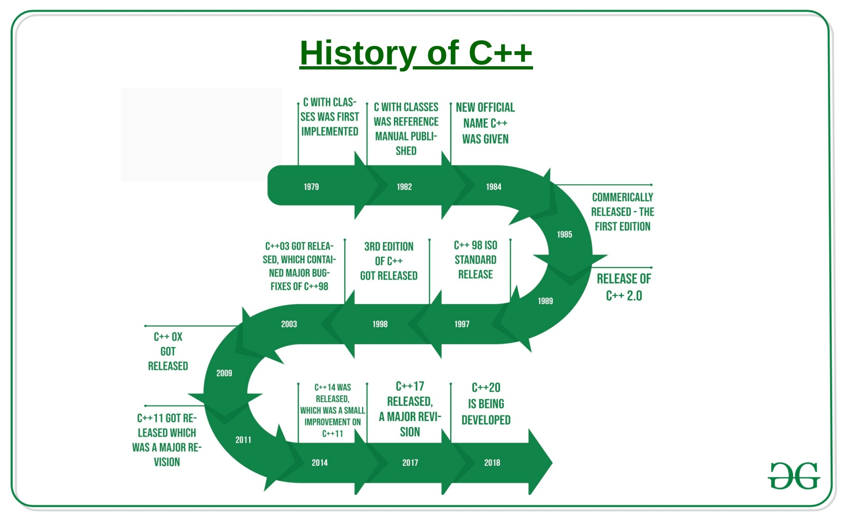
C++: History

Slide 5
C++: Why?
C++ is one of the world's most popular programming languages.
C++ can be found in today's operating systems, Graphical User Interfaces, system drivers, browsers, games and embedded systems.
Many major applications like Adobe Products like Photoshop, Illustrator, InDesign
Amazon - one of the biggest e-commerce sites
Autodesk products for Computer Aided Design
Facebook - social networking site are heavy C++ centric products.
C++ is an object oriented language which gives a clear structure to programs and allows code to be reused, lowering development costs.

Slide 6
C++: Why?
C++ is a middle level language, you will write code that interacts directly with the internal hardware of the computer.
how the computer memory really works, how information is stored in them, how you can retrieve them and so on.
Github, the leading open source collaboration platform, has over 600,000 repositories for C++ alone.
Over 400,000 C++ questions asked on StackOverflow, the number one Q&A platform for developers, more than 60% questions have been answered.
The number of questions asked and the percentage of them answered shows the interest and active support for C++ today.
As C++ is close to C# and Java, it makes it easy for programmers to switch to C++ or vice versa.

Slide 7
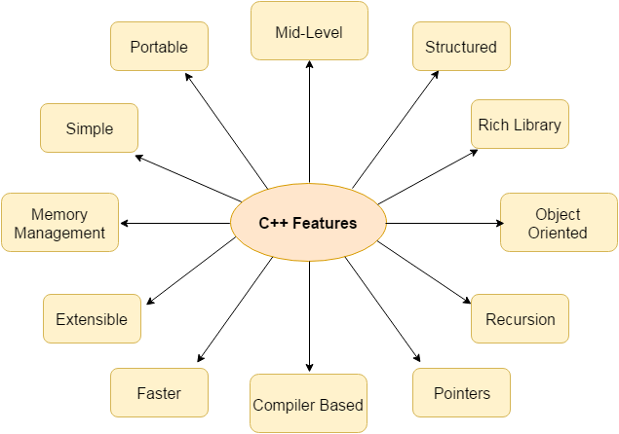
C++: Features

Slide 8
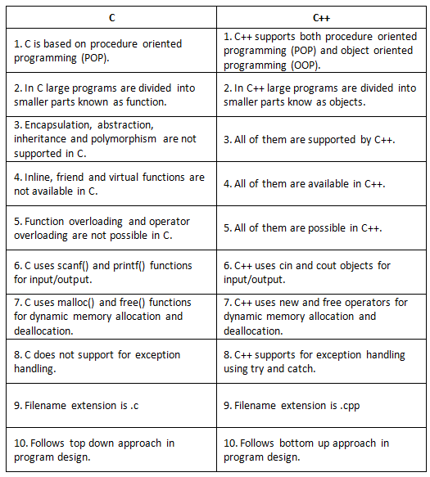
C Vs. C++

Slide 9
C++: Environmental Setup
There are lots of IDE available for windows operating system which you can use to work easily with C++ programming language.
Dev C++, Microsoft Visual Studio, Microsoft Visual C++, Code::blocks, NetBeans, Eclipse, etc.,
For Example take Code::Blocks IDE.
To download Code::Blocks you may visit this link. Once you have downloaded the setup file of Code::Blocks from the given link open it and follow the instruction to install.
After successfully installing Code::Blocks, go to File menu -> Select New and create an Empty file.
Now write your C++ program in this empty file and save the file with a ‘.cpp’ extension. For Example: Test.cpp .
After saving the file with ‘.cpp’ extension, go to Build menu and choose the Build and Run option.

Slide 10
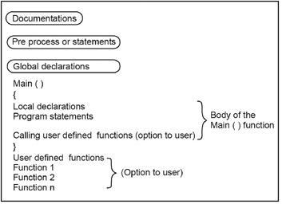
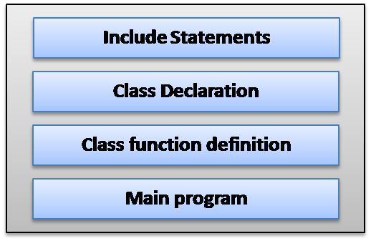
Basic Structure of C++ Program
POP
OOP

Slide 11
First C++ Program
OK
//First C++ Program
#include <iostream>
int main() {
std::cout << "Hello World!"; return 0;
}
//First C++ Program
#include <iostream>
using namespace std;
int main() {
cout << "Hello World!"; return 0;
}
Good
//First C++ Program
#include <iostream>
using std::cout;
int main() {
cout << "Hello World!"; return 0;
}
Bad

Slide 12
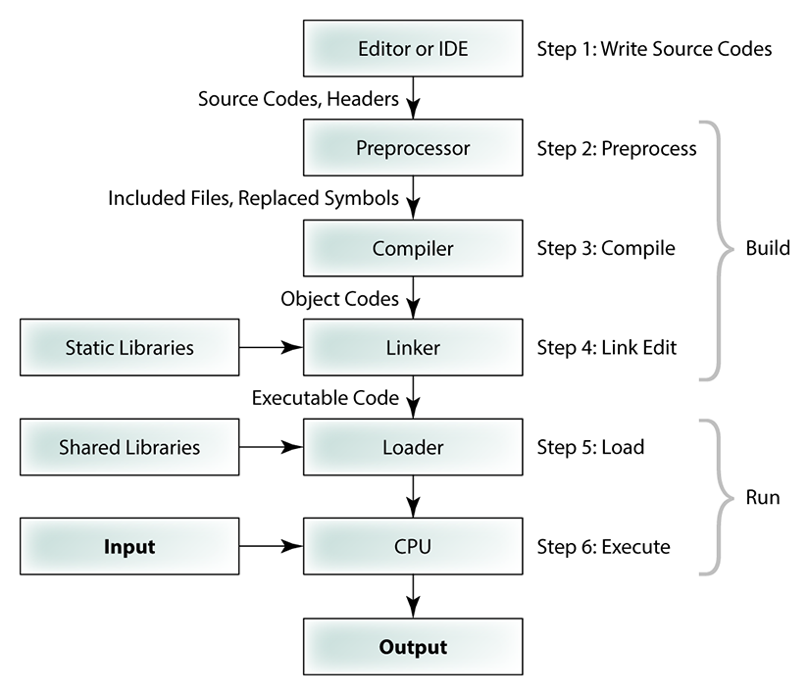
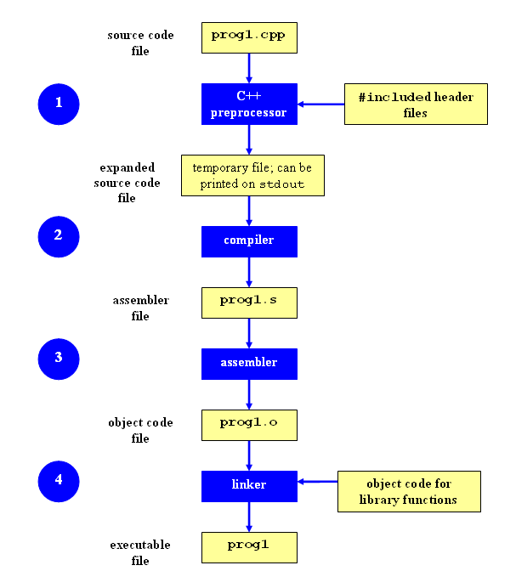
First C++ Program

Slide 13
First C++ Program
// First C++ Program
The first line in our program is a comment line.
Every line that starts with two slash signs ( // ) (Single Line Comments) are considered comments and will have no effect on the behaviour or outcome of the program.
Multi Line Comments (Words between /* and */ will also be considered as comments.
Use comments in your programs to explain difficult sections, but don’t overdo it.
It is also common practice to start every program with a brief description on what the program will do.
//First C++ Program
#include <iostream>
using namespace std;
int main() {
cout << "Hello World!"; return 0;
}

Slide 14
First C++ Program
#include<iostream>
Lines beginning with a pound sign (#) are used by the pre-processor.
In this case the directive #include tells the pre-processor to include the iostream standard file. This file iostream includes the declarations of the basic standard input/output library in C++.
//First C++ Program
#include <iostream>
using namespace std;
int main() {
cout << "Hello World!"; return 0;
}
#include<iostream> Vs #include<iostream.h>
iostream.h was a header file used by the early 1990's for use with early C++, before it was standardized.
iostream is the header file used by the C++ standard library, first published in 1998, to provide access to standard I/O streams.

Slide 15
First C++ Program
//First C++ Program
#include <iostream>
using namespace std;
int main() {
cout << "Hello World!"; return 0;
}
using namespace std;
All the elements of the standard C++ library are declared within what is called a namespace.
A namespace is like a region, where we have functions, variables etc and their scope is limited to that particular region. Here std is a namespace name, this tells the compiler to look into that particular region for all the variables, functions, etc.
We put this line in to declare that we will make use of the functionality offered in the namespace std.
Standard
using namespace std;
C++ keyword. It Introduces a name that is defined elsewhere into the declarative region where this using-declaration appears.

Slide 16
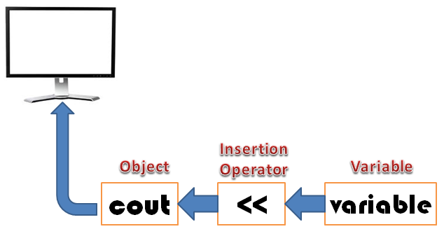
First C++ Program
//First C++ Program
#include <iostream>
using namespace std;
int main() {
cout << "Hello World!"; return 0;
}
cout << "Hello World!";
This line tells the compiler to print/display the message “Hello World” on the screen.
In C++, stream insertion operator “<<” is used for output and extraction operator “>>” is used for input.

Slide 17
First C++ Program
return 0;
The return statement causes the main function to finish. You may return a return code (in this case a zero) but it depends on how you start your function main( ).
We said that main ( ) will return an int (integer). So we have to return something (in this case a zero).
A zero normally indicates that everything went ok and a one normally indicates that something has gone wrong.
//First C++ Program
#include <iostream>
using namespace std;
int main() {
cout << "Hello World!"; return 0;
}

Slide 18
C++: Character Set
C++ Character set is basically a set of valid characters that a language can recognise. It convey a specific connotation to the compiler.
We use characters to represent letters, digits, special symbols, white spaces, and other characters.
The C++ character set consists of 3 main elements. They are:
Letters: These are alphabets ranging from A-Z and a-z (both uppercase and lowercase characters convey different meanings)
Digits: All the digits from 0 – 9 are valid in C++.
Special symbols: There are a variety of special symbols available in C++ like mathematical, logical and relational operators like +,-, *, /, \, ^, %, !, @, #, ^, &, (, ), [, ], ; and many more.

Slide 19
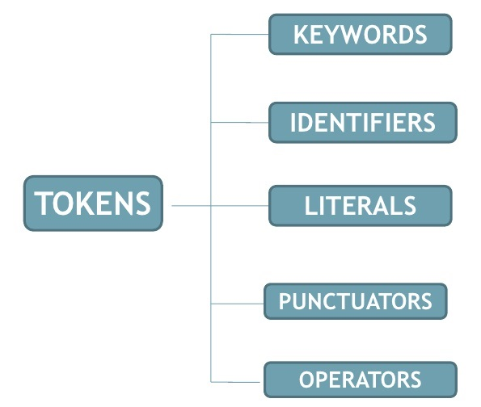
C++: Tokens
The smallest individual unit in a program is known as a Token.
C++ has the following tokens:

Slide 20
C++ Tokens: Identifiers
An identifier is the name given by the user for the various programming elements like variables, functions, arrays, structure, class and pointers.
C++ is case sensitive as it traits upper and lower case characters differently.
Rules:
First character: They must begin with a letter or underscore(_).
No special characters: They must consist of only letters, digits, or underscore. No other special character is allowed.
No keywords: It should not be a keyword.
No white spaces: It must not contain white space.
Word limit: It should be up to 31 characters long as only first 31 characters are significant.
Some Valid Identifiers:
name, _abc, file123, STUDENT, _ab_cd, FILE123
Some Invalid Identifiers:
int, 100abc, MY-FILE, abc.txt

Slide 21
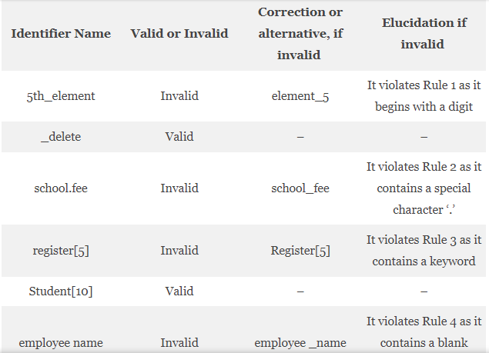
C++ Tokens: Identifiers

Slide 22
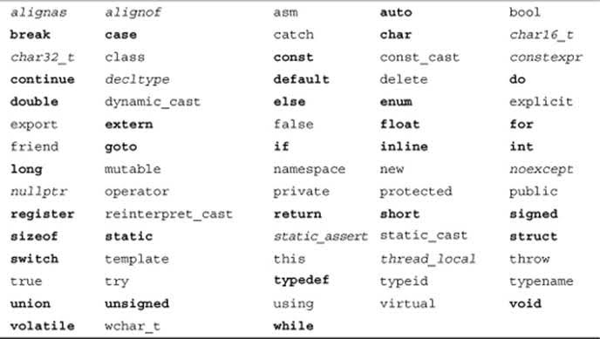
C++ Tokens: Keywords
The keywords are pre-defined or reserved words that convey a special meaning to the language compiler.
Some of the C++ keywords as follows:

Slide 23
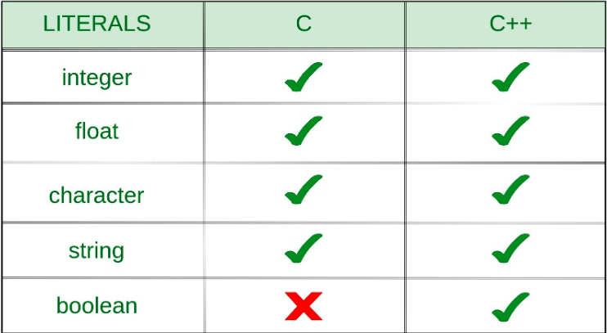
C++ Tokens: Literals
Literals (often referred to as constants) are data items that never change their value during a program run.
C++ allows several kinds of literals:
Integer constants (iii) Real or Floating point constants
Character constants (iv) String constants
Boolean Literals

Slide 24
C++ Tokens: Literals
Integer constants
Integer constants are whole numbers without any fractional part. These are used to represent and store the integer values.
C++ allows four types of integer constants:
Decimal (base 10): A non-zero decimal digit followed by zero or more decimal digits(0, 1, 2, 3, 4, 5, 6, 7, 8, 9).
For example: 56, 78
Octal (base 8): a 0 followed by zero or more octal digits(0, 1, 2, 3, 4, 5, 6, 7).
For example: 045, 076, 06210
Hexadecimal (base 16): 0x or 0X followed by one or more hexadecimal digits(0, 1, 2, 3, 4, 5, 6, 7, 8, 9, a, A, b, B, c, C, d, D, e, E, f, F).
For example: 0x23A, 0Xb4C, 0xFEA
Binary-literal(base 2): 0b or 0B followed by one or more binary digits(0, 1). For example: 0b101, 0B111

Slide 25
C++ Tokens: Literals
Real or Floating point constants
These are used to represent and store real numbers. The real number has an integer part, real part, fractional part and an exponential part.
The floating-point literals can be stored either in decimal form or exponential form. The signed exponent is introduced by e or E.
Example:
3.14159 // Legal
314159E-5L // Legal
510E // Illegal: incomplete exponent
210f // Illegal: no decimal or exponent
.e55 // Illegal: missing integer or fraction

Slide 26
C++ Tokens: Literals
Character Constants
This refers to the literals that are used to store a single character within a single quote.
Two Cases:
char type: This used to store normal character literal or the narrow-character literals. This is supported by both C and C++.
For Ex: char chr = 'G';
wchar_t type: This literal is supported only in C++ and not in C.
If the character is followed by L, then the literal needs to be stored in wchar_t. This represents wide-character literal.
For Ex: wchar_t chr = L'G';
Note:
A character literal can be a plain character (e.g., 'x'), an escape
sequence (e.g., '\t'), or a universal character (Unicode) (e.g.,'\u02C0').

Slide 27
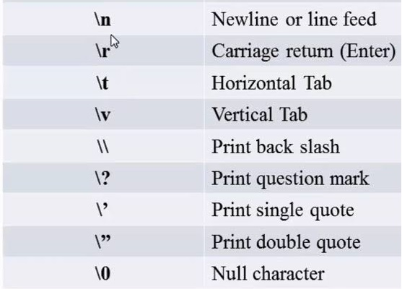
C++ Tokens: Literals
Character Constants
Escape sequences are special characters used in control string to modify the format of an output.
These specific characters are translated into another character or a sequence of characters that may be difficult to represent directly.
For example, you want to put a line break in the output of a C++ statement then you will use “\n” character which is an escape sequence itself.

Slide 28
C++ Tokens: Literals
String Constants
String literals are similar to that of the character literals, except that it can store multiple characters and uses a double quote to store the same.
Example:
For C & C++: char name[30] = ‘’Hello!”; char name[] = “Hello!”;
char name[30] = { ‘H’ , ’e’ , ’l’ , ’l’ , ’o’};
For C++
string name = “Hello”;
Boolean Constants
This literal is provided only in C++ and not in C. They are used to represent the boolean data types.
These can carry two values:
true: To represent True value. This must not be considered equal to int 1.
false: To represent False value. This must not be considered equal to int 0.

Slide 29
C++ Tokens: Punctuators
Special symbols
Special Symbols: C++ Punctuators or Separators are Special Symbols used to Indicate the group of code that is either be divided or arrange into the Block.
Brackets[]: Opening and closing brackets are used as array element reference. These indicate single and multidimensional subscripts.
Parentheses(): These special symbols are used to indicate function calls and function parameters.
Braces{}: These opening and ending curly braces marks the start and end of a block of code containing more than one executable statement.
comma (, ): It is used to separate more than one statements like for separating parameters in function calls.
semi colon : It is an operator that essentially invokes something called an initialization list.
asterisk (*): It is used to create pointer variable.
assignment operator: It is used to assign values.
preprocessor(#): The preprocessor is a macro processor that is used automatically by the compiler to transform your program before actual compilation.

Slide 30
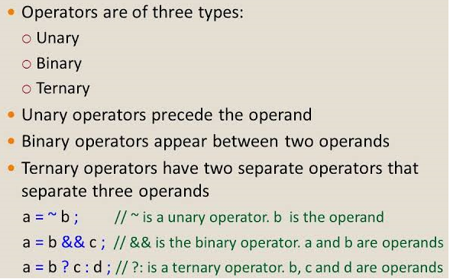
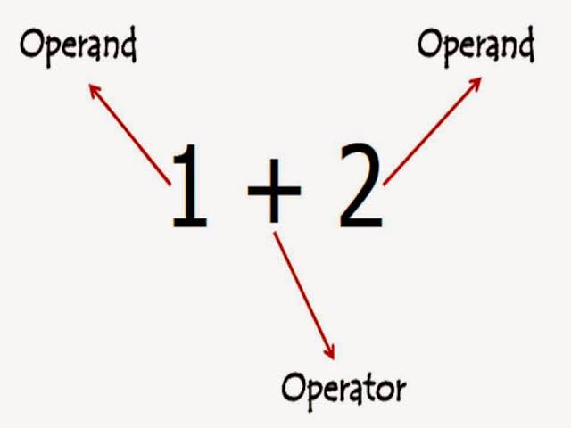
C++ Tokens: Operators
Operators
It represents an action. We can define operators as symbols that help us to perform specific mathematical and logical computations on operands.

Slide 31
Unary Operators in C/C++
Types of Unary Operator | Operator Symbol | Example
Increment / Decrement It is used to increment / decrement the value of the variable by 1 | Increment ++ Decrement -- | prefix increment int a = 1; int b = ++a; // b = 2 postfix increment int a = 1; int b = a++; // b = 1 int c = a; // c = 2 prefix decrement int a = 1; int b = --a; // b = 0 posfix decrement int a = 1; int b = a--; // b = 1 int c = a; // c = 0 Increment_decrement.cpp
Unary minus The minus operator changes the sign of its argument | - | int a = 10; int b = -a; // b = -10
NOT: It is used to reverse the logical state of its operand. | ! | If x is true, then !x is false If x is false, then !x is true

Slide 32
Unary Operators in C/C++
Types of Unary Operator | Operator Symbol | Example
Address of operator It gives an address of a variable. It is used to return the memory address of a variable. | & | int a; int *ptr; ptr = &a; // address of a is copied to the location ptr.
Indirection Operator It returns the value of the variable located at the address specified by its operand. | * | int a=10; int *ptr; ptr = &a; // address of a is copied to the location ptr. Cout<<*ptr; //10
sizeof() This operator returns the size of its operand, in bytes. The sizeof operator always precedes its operand. | - | float n = 0; cout << "size of n: " << sizeof(n); //4 bytes

Slide 33
Binary Operators in C/C++
Types of Binary Operator | Operator Symbol | Example
Arithmetic Operators These are used to perform arithmetic/mathematical operations on operands. | +, -, *, /, % | Int a=20, b=10, c; c=a+b; //c=30 c=a-b; //c=10 c=a*b; //c=200 c=a/b; //c=2 c=a%b; //c=0
Relational Operators Relational operators are used for comparison of two values to understand the type of relationship a pair of number shares. | <, <=, >, >=, ==, != | relation.cpp
Logical Operators Logical Operators are used to combine two or more conditions/constraints or to complement the evaluation of the original condition in consideration. The result of the operation of a logical operator is a boolean value either true or false. | Logical AND (&&) Logical OR (||) | logical.cpp

Slide 34
Binary Operators in C/C++
Types of Binary Operator | Operator Symbol | Example
Bitwise Operators Bitwise operators are used for manipulating a data at the bit level, also called as bit level programming. Bit-level programming mainly consists of 0 and 1. They are used in numerical computations to make the calculation process faster. | Bitwise AND (&) Bitwise OR (|) Bitwise Exclusive OR (^) ~ One's Complement (unary operator) << Left shift operator >> Right shift operator | Int a=20, b=10, c; c=a+b; //c=30 c=a-b; //c=10 c=a*b; //c=200 c=a/b; //c=2 c=a%b; //c=0 bitwise.cpp
Assignment Operators: Assignment operators are used to assign value to a variable. The left side operand of the assignment operator is a variable and right side operand of the assignment operator is a value. The value on the right side must be of the same data-type of variable on the left side otherwise the compiler will raise an error. | = Shorthand Assignment Operator += -= *= /= | a = 10; b = 20; ch = 'y'; (a += b) can be written as (a = a + b)

Slide 35
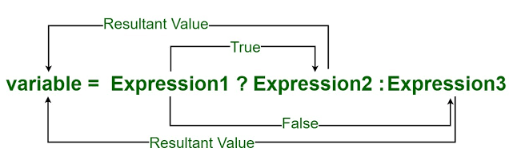
Ternary Operators in C/C++
Type of Ternary Operator | Operator Symbol | Example
Conditional Operator The conditional operator can often be used instead of the if else statement. Since it is the only operator that requires three operands in C/C++, It is also called the ternary operator. | ?: | variable = Expression1 ? Expression2 : Expression3 ternary.cpp

Slide 36
Special Operators in C/C++
Types of Special Operator | Operator Symbol | Example
Comma operator It causes a sequence of operations to be performed. The value of the entire comma expression is the value of the last expression of the comma-separated list. | , | int a,b,c; // variables declaration using comma operator a=b++, c++; // a = c++ will be done.
Member selection operators These are used to reference individual members of classes, structures, and unions. | . (dot) -> (arrow) | object.member; object->member;
Scope Resolution Operator Scope is an enclosing context where values and expressions are associated. The scope resolution operator helps to identify and specify the context to which an identifier refers, particularly by specifying a namespace. It is used to define a function outside a class or when we want to use a global variable but also has a local variable with the same name. | :: | Scope.cpp

Slide 37
Special Operators in C/C++
Types of Special Operator | Operator Symbol | Example
Cast Casting operators convert one data type to another. | (type) expression | cast.cpp
new The new operator denotes a request for memory allocation on the Heap. If sufficient memory is available, new operator initializes the memory and returns the address of the newly allocated and initialized memory to the pointer variable. | pointer-variable = new data-type; | int *p = new int; Initialize int *p = new int(25); Allocate block of memory int *p = new int[10]
delete To deallocate dynamically allocated memory | delete pointer-variable; | delete p; delete[] p;

Slide 38
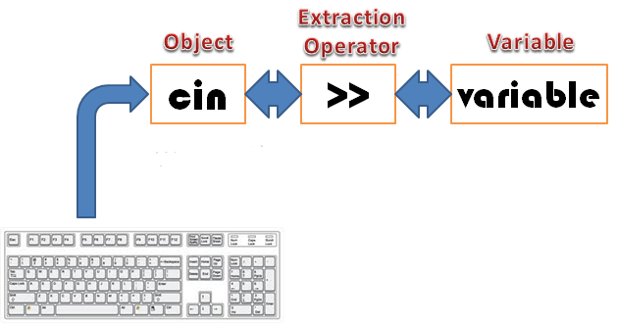
I/O Operators in C/C++
Types of IO Operator | Operator Symbol | Example
I/O Operators The operator used for taking the input is known as the extraction or get from operator (>>), while the operator used for displaying the output is known as the insertion or put to operator (<<). | >> << | int a; cin>>a; //5 a=a+1; cout<<a; //6

Slide 39
Expressions
Expressions
An expression in C++ is any valid combination of tokens like variables, constants and operators.
An expression may consist of one or more operands, and zero or more operators to produce a value.
Examples:
a+b*c
(a*b)/(c+d)
++a&&b++||c
etc.,

Slide 40
Expression evaluation
Operator Precedence
It determines which operator is performed first in an expression with more than one operators with different precedence.
Operators Associativity
It is used when two operators of same precedence appear in an expression. Associativity can be either Left to Right or Right to Left.

Slide 41
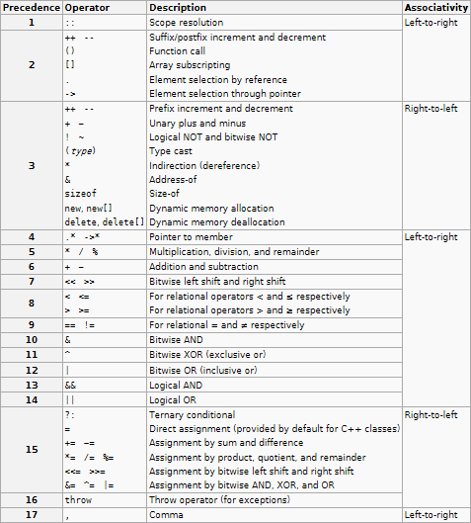
Expression evaluation

Slide 42
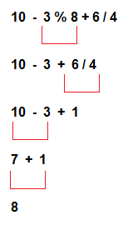
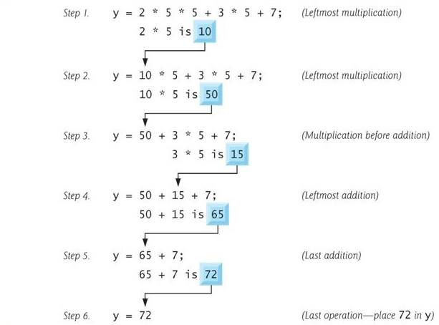
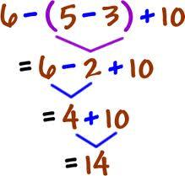
Expression evaluation
Example 1
Example 2
Example 3

Slide 43
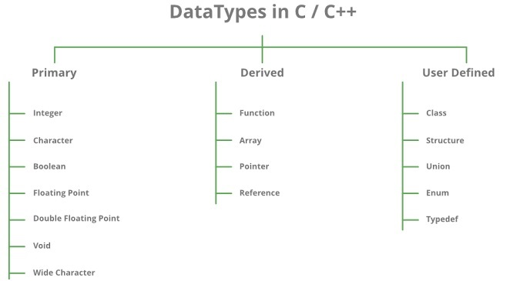
Data Types
Data types define the type of data a variable can hold, for example an integer variable can hold integer data, a character type variable can hold character data etc.

Slide 44
Data Types
Wide Character: Wide character data type is also a character data type but this data type has size greater than the normal 8-bit datatype. Represented by wchar_t. It is generally 2 or 4 bytes long.
If the character is followed by L, then the literal needs to be stored in wchar_t. This represents wide-character literal.
Wide char can take on 65536 values which corresponds to UNICODE values which is a recent international standard which allows for the encoding of characters for virtually all languages and commonly used symbols.
Example: wide_char.cpp

Slide 45
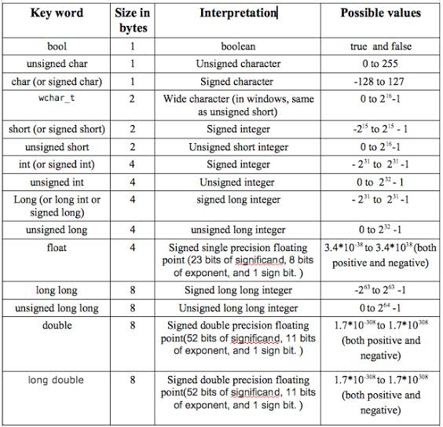
Data Types
Data Type Modifiers
As the name implies, data type modifiers are used with the built-in data types to modify the length of data that a particular data type can hold.
Data type modifiers available in C++ are: Signed, Unsigned, Short and Long.

Slide 46
Type Conversation
The process of converting one predefined type into another type is called Type Conversion.
Two Types:
Implicit or automatic type conversion
Done by the compiler on its own, without any external trigger from the user.
Generally takes place when in an expression more than one data type is present.
All the data types of the variables are upgraded to the data type of the variable with largest data type.
Example: implicit.cpp
Explicit type conversation
This is done by explicitly defining the required type in front of the expression in parenthesis. This can be also considered as forceful casting.
Example: explicit.cpp

Slide 47
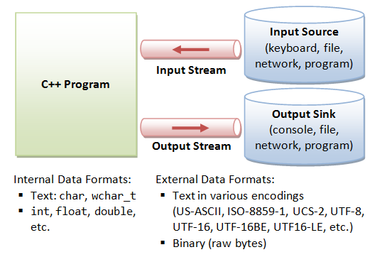
Input/output in C++
C++ IO is based on streams, which are a sequence of bytes flowing in and out of the programs (just like water and oil flowing through a pipe).
I/O systems in C++ are designed to work with a wide variety of devices including terminals, disks and tape drives.
Input Stream: If the direction of flow of bytes is from the device(for example, Keyboard) to the main memory then this process is called input.
Output Stream: If the direction of flow of bytes is opposite, i.e. from main memory to device( display screen ) then this process is called output

Slide 48
Input/output in C++
I/O Header Files
<iostream>
This file defines the cin, cout, cerr and clog objects, which correspond to the standard input stream, the standard output stream, the un-buffered standard error stream and the buffered standard error stream, respectively.
<iomanip>
This file declares services useful for performing formatted I/O with so-called parameterized stream manipulators, such as setw and setprecision.
<fstream>
This file declares services for user-controlled file processing

Slide 49
Input/output in C++
Standard output stream (cout):
Usually the standard output device is the display screen.
The C++ cout statement is the instance of the ostream class.
It is used to produce output on the standard output device which is usually the display screen.
The data needed to be displayed on the screen is inserted in the standard output stream (cout) using the insertion operator(<<).
Standard input stream (cin):
Usually the input device in a computer is the keyboard.
C++ cin statement is the instance of the class istream and is used to read input from the standard input device which is usually a keyboard.
The extraction operator(>>) is used along with the object cin for reading inputs. The extraction operator extracts the data from the object cin which is entered using the keyboard.
Example: IO1.cpp, IO2.cpp

Slide 50
Input/output in C++
The Standard Error Stream (cerr):
The Standard Error Stream or cerr is a predefined object of the ostream class.
C++ programs are written by humans and the humans are prone to commit errors, so the standard error stream or cerr is attached to the standard error device, which is also a display screen, just like the standard output stream cout.
However, the cerr is un-buffered and each stream insertion to cerr causes its output to appear immediately.
Example: cerr.cpp

Slide 51
Input/output in C++
The Standard Log Stream (clog):
The predefined object of the Standard Log Stream, clog is also an instance of ostream class.
The clog object is said to be attached to the standard error device, which is also a display screen but the object clog is buffered.
This means that each insertion to clog could cause its output to be held in a buffer until the buffer is filled or until the buffer is flushed.
It works in a similar manner to the standard error stream object, cerr.
Example: clog.cpp

Slide 52
Input/output in C++
Unformatted I/O Operations:
get() & put():
The classes istream and ostream defines two member functions get() and put() respectively to handle single character input/output operations.
Both of them can be used to fetch a character including blank space, tab or new-line character.
Example: unformatted1.cpp

Slide 53
Input/output in C++
Unformatted I/O Operations:
getline() & write():
Read and display lines of text more efficiently using the line oriented input/output functions. This function reads complete string until a give delimiter or null match.
getline() function reads the entire line of texts that ends with a newline character. The general form of getline() is:
cin.getline (line, size);
write() function displays the entire line of text, and the general form of writing this function is:
cout.write (line, size); Example: unformatted2.cpp

Slide 54
Input/output in C++: Manipulators
Manipulators are operators used in C++ for formatting output. The data is manipulated by the programmer's choice of display.
It is helping functions that can modify the input/output stream. It does not mean that we change the value of a variable, it only modifies the I/O stream using insertion (<<) and extraction (>>) operators.
Types of manipulators
ws: It is defined in istream and is used to ignore the whitespaces in the string sequence.
Note: istringstream is for input, ostringstream for output. stringstream is input and output.

Slide 55
Input/output in C++: Manipulators
Types of manipulators
endl: It is defined in ostream. It is used to enter a new line and after entering a new line it flushes (i.e. it forces all the output written on the screen or in the file) the output stream.
endl vs \n in C++
cout << endl : Inserts a new line and flushes the stream
cout << "\n" : Only inserts a new line.
Some other differences between endl and \n are:
endl is manipulator while \n is character.
endl doesn’t occupy any memory whereas \n is character so It occupy 1 byte memory.
We cannot write endl in between double quotation while we can write \n in between double quotation like cout<<"\n"; it is right but cout<<"endl"; is wrong.
We can use \n also in C++ but we can't use endl in C language.

Slide 56
Input/output in C++: Manipulators
Types of manipulators
ends: It is also defined in ostream and it inserts a null character into the output stream. It typically works with std::ostrstream, when the associated output buffer needs to be null-terminated to be processed as a C string.
flush: It is also defined in ostream and it flushes the output stream i.e. it forces all the output written on the screen or in the file. Without flush, the output would be the same but may not appear in real-time.
Some important manipulators in <iomanip>
setw (val): It is used to sets the field width in output operations.
setfill (c): It is used to fill the character ‘c’ on output stream.
setprecision (val): It sets val as the new value for the precision of floating-point values.

Slide 57
Input/output in C++: Manipulators
Some important manipulators in <iomanip>
setbase(val): It is used to set the numeric base value for numeric values.
setiosflags(flag): It is used to sets the format flags specified by parameter mask.
resetiosflags(m): It is used to resets the format flags specified by parameter mask.
mask: mask representing the flags to be set.
Some important manipulators in <ios> are:
showpos: It forces to show a positive sign on positive numbers.
noshowpos: It forces not to write a positive sign on positive numbers.
showbase: It indicates numeric base of numeric values.
uppercase: It forces uppercase letters for numeric values.

Slide 58
Input/output in C++: Manipulators
Some important manipulators in <ios> are:
nouppercase: It forces lowercase letters for numeric values.
fixed: It uses decimal notation for floating-point values.
scientific: It use scientific floating-point notation.
hex: Read and write hexadecimal values for integers and it works same as the setbase(16).
dec: Read and write decimal values for integers i.e. setbase(10).
oct: Read and write octal values for integers i.e. setbase(8).
left: It adjust output to the left.
right: It adjust output to the right.
Example: manipulator1.cpp, manipulator2.cpp, manipulator3.cpp, manipulator4.cpp, manipulator5.cpp

Slide 59
Scientific notation: Introduction
Scientific notation is a useful shorthand for writing lengthy numbers in a concise manner.
Numbers in scientific notation take the following form: significant x 10^{exponent}.
For example, in the scientific notation 1.2 x 10⁴, 1.2 is the significant and 4 is the exponent.
Since 10⁴ evaluates to 10,000, 1.2 x 10⁴ evaluates to 12,000.
Scientific notation has the added benefit of making it easier to compare the magnitude of two really large or really small numbers simply by comparing the exponent.
In C++, we use the letter ‘e’ (or sometimes ‘E’) to represent the “times 10 to the power of” part of the equation.
For example, 1.2 x 10⁴ would be written as 1.2e4, and 5.9736 x 10²⁴ would be written as 5.9736e24.

Slide 60
Scientific notation: Introduction
How to convert numbers to scientific notation
Steps:
Your exponent starts at zero.
Slide the decimal so there is only one non-zero digit to the left of the decimal.
Each place you slide the decimal to the left increases the exponent by 1.
Each place you slide the decimal to the right decreases the exponent by 1.
Trim off any leading zeros (on the left end of the significant)
Trim off any trailing zeros (on the right end of the significant) only if the original number had no decimal point. We’re assuming they’re not significant unless otherwise specified.

Slide 61
Scientific notation: Introduction
How to convert numbers to scientific notation
Example1:
Start with: 42030 Slide decimal left 4 spaces: 4.2030e4
No leading zeros to trim: 4.2030e4
Trim trailing zeros: 4.203e4 (4 significant digits)
Example 2:
Start with: 600.410 Slide decimal left 2 spaces: 6.00410e2
No leading zeros to trim: 6.00410e2
Don't trim trailing zeros: 6.00410e2 (6 significant digits)
Example 3:
Start with: 0.0078900 Slide decimal right 3 spaces: 0007.8900e-3 Trim leading zeros: 7.8900e-3
Don't trim trailing zeros: 7.8900e-3 (5 significant digits)
Note: The digits in the significant (the part before the ‘e’) are called the significant digits. The number of significant digits defines a number’s precision. The more digits in the significant, the more precise a number is.

Slide 62
Floating point numbers
A floating point type variable is a variable that can hold a real number, such as 4320.0, -3.33, or 0.01226.
The floating part of the name floating point refers to the fact that the decimal point can “float”; that is, it can support a variable number of digits before and after the decimal point.
There are three different floating point data types: float, double, and long double.
As with integers, C++ does not define the actual size of these types (but it does guarantee minimum sizes).
On modern architectures, floating point representation almost always follows IEEE 754 binary format. In this format, a float is 4 bytes, a double is 8, and a long double can be equivalent to a double (8 bytes), 80-bits (often padded to 12 bytes), or 16 bytes.
Floating point data types are always signed (can hold positive and negative values).

Slide 63
Floating point numbers
The precision of a floating point number defines how many significant digits it can represent without information loss.
When outputting floating point numbers, std::cout has a default precision of 6 -- that is, it assumes all floating point variables are only significant to 6 digits (the minimum precision of a float), and hence it will truncate anything after that.
Float values have between 6 and 9 digits of precision, with most float values having at least 7 significant digits.
Double values have between 15 and 18 digits of precision, with most double values having at least 16 significant digits.
Long double has a minimum precision of 15, 18, or 33 significant digits depending on how many bytes it occupies.
Example: floating1.cpp, floating2.cpp

Slide 64
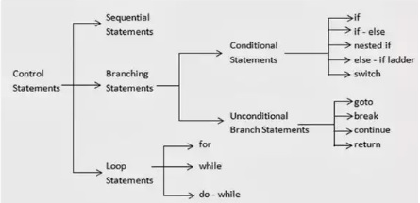
Control Statements in C++
Control statements are elements in the source code that control the flow of program execution.
There are two types of control statements: conditional and unconditional.

Slide 65
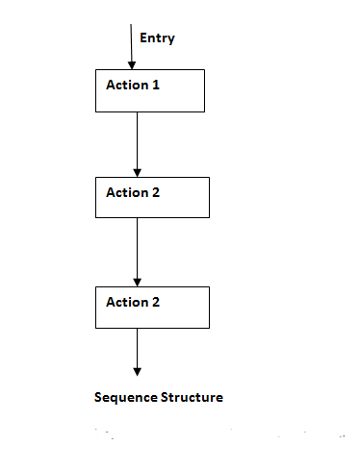
Control Statements in C++
Sequential Statements:
Program using identifiers, operators, expressions, etc. Here no need of branching and looping statements.
Example: Swap1.cpp, Swap2.cpp, Fahrenheit.cpp
Practice:
Write C++ program for the following problem:
1. Swap two numbers using bitwise operator.
2. Convert Celsius to Fahrenheit.
3. Convert Rupee to any five country currency
like dollar, euro.
4. Convert centimetre into meter and kilometre.

Slide 66
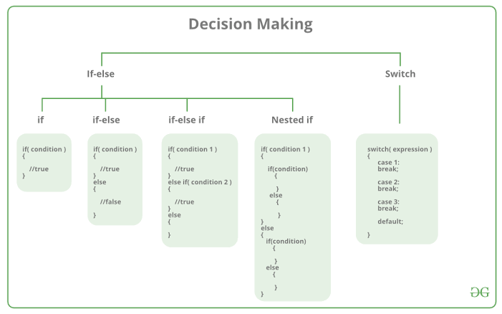
Control Statements in C++
Conditional Statements also known as selection statements, are used to make decisions based on a given condition. If the condition evaluates to True, a set of statements is executed, otherwise another set of statements is executed.

Slide 67
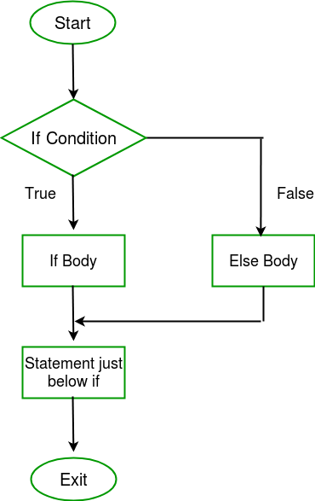
Control Statements in C++
Simple If
The if statement evaluates the test expression inside parenthesis.
If test expression is evaluated to true, statements inside the body of if is executed.
If test expression is evaluated to false, statements inside the body of if is skipped.
Example: Asolute.cpp, Number_Check.cpp
Practice:
Write C++ program for the following problem:
To check the entered mark is pass (if it is greater than 40).
To check whether given number is divisor of 7.

Slide 68
Control Statements in C++
If-else
The if statement evaluates the test expression inside parenthesis.
If test expression is evaluated to true, statements inside the body of if is executed.
If test expression is evaluated to false, statements inside the body of else is executed. Example: Positive_Negative.cpp, Vowel_Consonant.cpp, Leap_Year.cpp
Practice:
Write C++ program for the following problem:
To check whether the given number is odd or even.
To check largest of two numbers.
To check whether the given number is positive or negative.
To check whether the given character is uppercase or not.

Slide 69
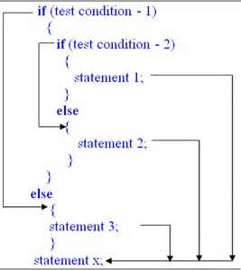
Control Statements in C++
Nested if
It means you can use one if or else if statement inside another if or else if statement(s).
It is always legal to nest if-else statements.
Example: largest.cpp,
Vowel.cpp
Practice:
Write C++ program for the following problem:
To Read a Coordinate Point in a XY Coordinate System and Determine its Quadrant.
To check whether the given digit is in between 75 and 100.

Slide 70
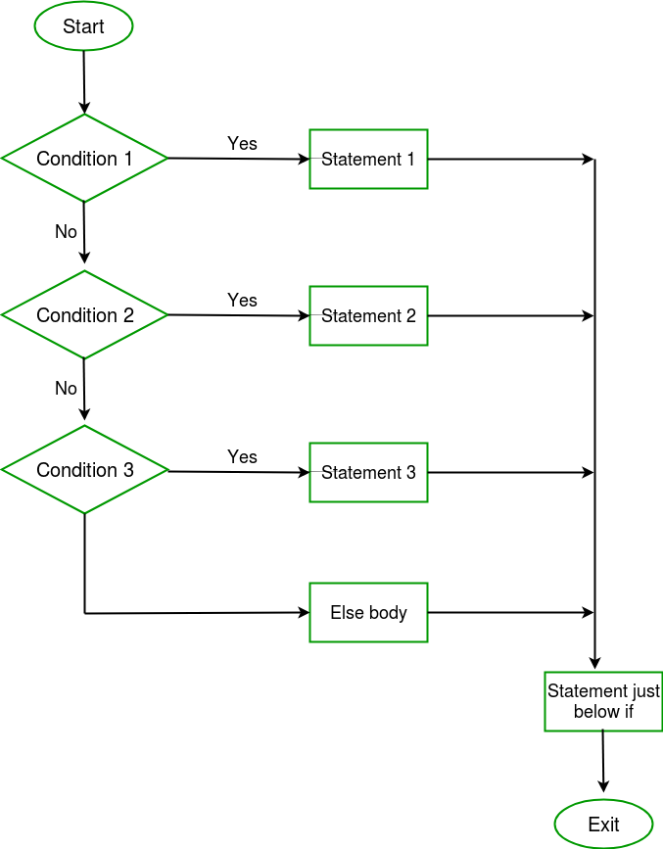
Control Statements in C++
If-else-if
The C++ if-else-if ladder statement executes one condition from multiple statements.
Example: Grade.cpp, Digit.cpp

Slide 71
Control Statements in C++
If-else-if
Practice:
Write C++ program for the following problem:
To Check whether the given Character is a Vowel /Consonant /Digit /Special Symbol.
To input basic salary of an employee and calculate gross salary according to given conditions. Basic Salary <= 10000 : HRA = 20%, DA = 80% Basic Salary is between 10001 to 20000 : HRA = 25%, DA = 90% Basic Salary >= 20001 : HRA = 30%, DA = 95%
Gross Salary=Basic Salary + HRA + DA

Slide 72
Control Statements in C++
Switch Case
The main purpose of switch statement is to select one of many possible statements to execute.
The if statement allows you to select one of two sections of code to execute based on a Boolean value (only two possible values). The switch statement allows you to choose from many statements based on an integer (including char) or enum value.
If we do not use break at the end of our each case, Then the compiler executes all case statements defined after the case user chooses.
Case Statements should be integers or characters. No number with a decimal point should be there (with case statement).
Example: Color.cpp
Practice: Write C++ program for the following problem:
To Check the given Character is a Vowel.
Simple Calculator (Try both integer (1,2,3) and character(+, -, *, /, %) as a case in separate program)

Slide 73
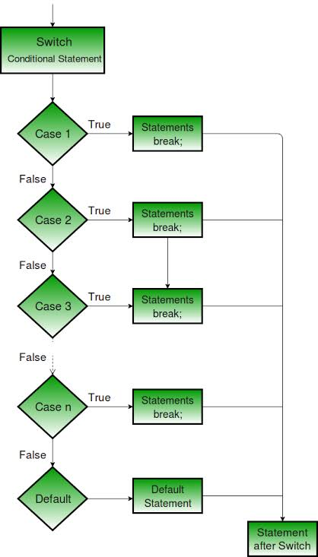
Control Statements in C++
Switch Case

Slide 74
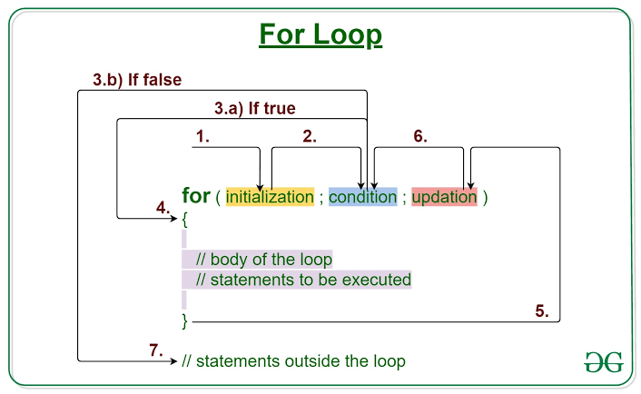
Control Statements in C++
Loop Statements also known as iterative statements, are used for executing a block of statements repeatedly until a particular condition is satisfied. In C++ we have three types of basic loops: for, while and do-while.
For Loop: A for loop is a repetition control structure that allows you to efficiently write a loop that needs to execute a specific number of times.
First step: In for loop, initialization happens first and only once, which means that the initialization part of for loop only executes once.

Slide 75
Control Statements in C++
Loop Statements also known as iterative statements, are used for executing a block of statements repeatedly until a particular condition is satisfied. In C++ we have three types of basic loops: for, while and do-while.
For Loop: A for loop is a repetition control structure that allows you to efficiently write a loop that needs to execute a specific number of times.
1): In for loop, initialization happens first and only once, which means that the initialization part of for loop only executes once.

Slide 76
Control Statements in C++
For Loop:
2, 3a, 3b, 4): Condition in for loop is evaluated on each loop iteration, if the condition is true then the statements inside for loop body gets executed. Once the condition returns false, the statements in for loop does not execute and the control gets transferred to the next statement in the program after for loop.
5): After every execution of for loop’s body, the increment/decrement part of for loop executes that updates the loop counter.
6): After third step, the control jumps to second step and condition is re-evaluated.
7): The steps from second to fourth repeats until the loop condition returns false.
Example: print.cpp, print1.cpp, factorial.cpp, Multiplication_Table.cpp

Slide 77
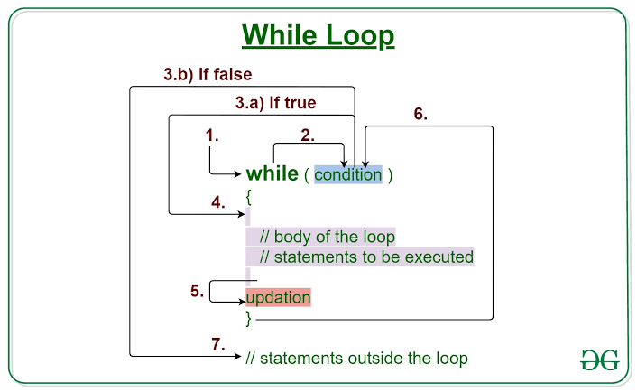
Control Statements in C++
while Loop: The while loop in C/C++ is used in situations where we do not know the exact number of iterations of loop beforehand. The loop execution is terminated on the basis of the test condition.
Steps:
Control falls into the while loop.
The flow jumps to Condition
Condition is tested.
If Condition yields true, the flow goes into the Body.
If Condition yields false, the flow goes outside the loop
The statements inside the body of the loop get executed.
Updation takes place.
Control flows back to Step 2.
The do-while loop has ended and the flow has gone outside.
Example:
print_for.cpp, reverse.cpp

Slide 78
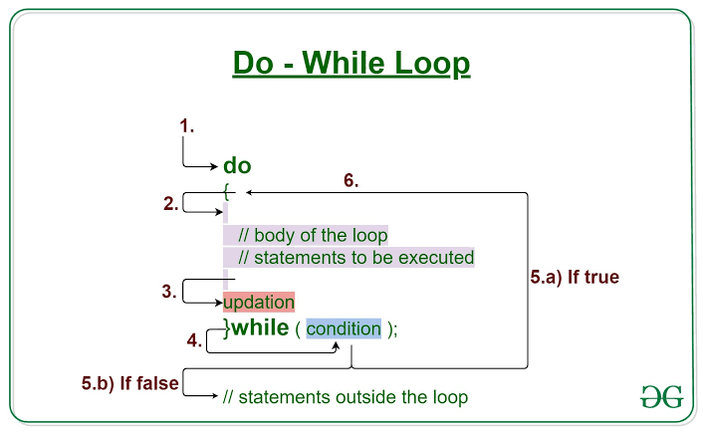
Control Statements in C++
Like while the do-while loop execution is also terminated on the basis of a test condition.
The main difference between a do-while loop and while loop is in the do-while loop the condition is tested at the end of the loop body, i.e do-while loop is exit controlled whereas the other two loops (for & while) are entry controlled loops.
In do-while loop the loop body will execute at least once irrespective of test condition.

Slide 79
Control Statements in C++
Steps:
Control falls into the do-while loop.
The statements inside the body of the loop get executed.
Updation takes place.
The flow jumps to Condition
Condition is tested.
If Condition yields true, goto Step 6.
If Condition yields false, the flow goes outside the loop
Flow goes back to Step 2.
Example:
print_dowhile.cpp, sum.cpp

Slide 80
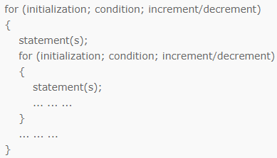
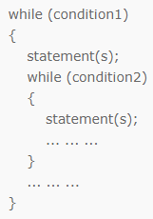
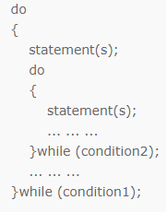
Control Statements in C++
Nested Loop: A loop inside another loop is called a nested loop. The number of loops depend on the complexity of a problem.
Suppose, a loop, outer loop, running n number of times consists of another loop inside it, inner loop, running m number of times. Then, for each execution of the outer loop from 1...n, the inner loop runs maximum of m times.
Syntax:
Example: pattern1.cpp, pattern2.cpp, pattern3.cpp, prime.cpp
More Examples for Practice: Menu_Driven.cpp
https://www.w3resource.com/cpp-exercises/for-loop/index.php

Slide 81
Control Statements in C++
Unconditional Control Statements
It is used to transfers the control from one part of the program to another without any condition.
In C++ Programming Language, there are four types of unconditional control transfer statements.
break
Continue
goto
return
1. break statement:
The break statement is used to transfer the control to the end of a statement block in a loop.
It is an unavoidable statement to transfer the control to the end of a switch statement after executing anyone statement block.
syntax: break;
Example: prime_check.cpp

Slide 82
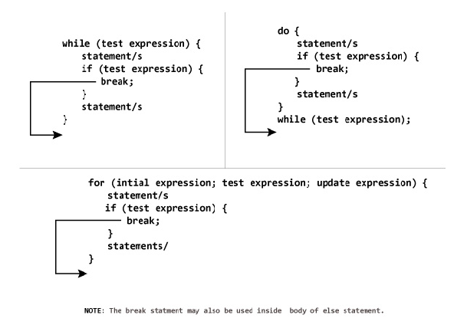
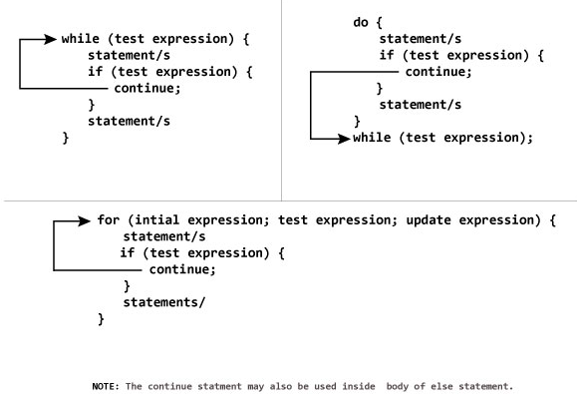
Control Statements in C++
2. continue statement:
The continue statement is used to transfer the control to the beginning of a statement block in a loop.
syntax: continue;
Example: print_number.cpp

Slide 83
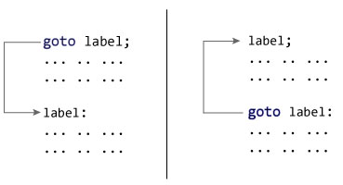
Control Statements in C++
3. goto: The goto statement can be used to jump from anywhere to anywhere within a function.
Two Types
(i) Forward goto
Possible to skip some statements
(ii) Backward goto
Possible for infinite loop
Note:
To avoid this problem, specify with appropriate condition
Reason to Avoid goto Statement
The goto statement gives power to jump to any part of program but, makes the logic of the program complex and tangled.
In modern programming, goto statement is considered a harmful construct and a bad programming practice.
The goto statement can be replaced in most of C++ program with the use of break and continue statements.
Example: goto1.cpp, goto2.cpp

Slide 84
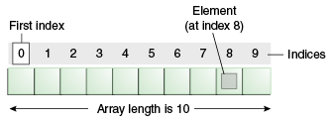
Array in C++
Like ‘C’ in ‘C++, Array is a derived data type. They are used to store similar type of elements as in the data type must be the same for all elements.
It is a collection of items stored at contiguous memory locations and elements can be accessed randomly using indices of an array.
Why do we need arrays? #) We can use normal variables (v1, v2, v3, ..) when we have a small number of objects, but if we want to store a large number of instances, it becomes difficult to manage them with normal variables.
#) The idea of an array is to represent many instances in one variable.

Slide 85
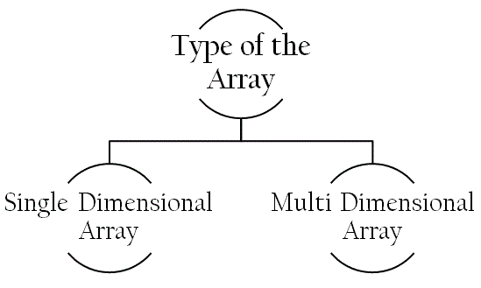
Array in C++
Types
Array can be divided into following types:
Single Dimensional Array
An array in which data are arranged linearly in only one dimension is called one dimensional array. It is commonly known as 1-D array. Syntax: datatype array_name[size];
Example:
int varName[10]; //Here, varName has 10 containers,
varName[0], varName[1] to varName[9]

Slide 86
Array in C++
Single Dimensional Array
Examples:
Level 1:
To read ‘N’ numbers and print the same
To read and print ‘N’ students Registration number and name
To read ‘N’ students OOPs subject marks and find the average
Level 2:
To find the minimum and maximum element of the given array of ‘N’ elements
To find whether given element is present or not in an array
To count frequencies of array elements
To sort the given array elements in descending order
Level 3:
https://www.w3resource.com/cpp-exercises/array/index.php

Slide 87
Array in C++
Multi Dimensional Array
In C/C++, we can define multidimensional arrays in simple words as array of arrays. Data in multidimensional arrays are stored in tabular form (in row major order).
Syntax:
data_type array_name[size1][size2]....[sizeN];
data_type: Type of data to be stored in the array.
array_name: Name of the array
size1, size2,... ,sizeN: Sizes of the dimensions
Example:
Two dimensional array: int two_d[10][20];
Three dimensional array: int three_d[10][20][30];

Slide 88
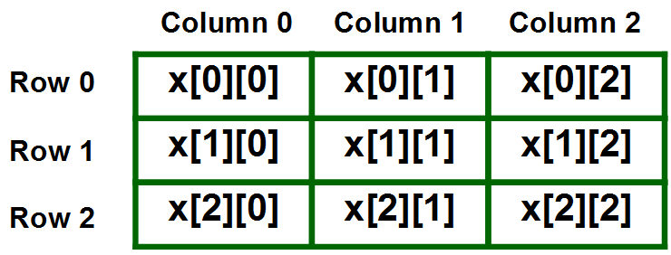
Array in C++
Two Dimensional Array
Two dimensional array is the simplest form of a multidimensional array.
A two dimensional array can be seen as a table with ‘x’ rows and ‘y’ columns where the row number ranges from 0 to (x-1) and column number ranges from 0 to (y-1).
A two dimensional array ‘x’ with 3 rows and 3 columns is shown below: Example: int X[3][3];

Slide 89
Array in C++
Examples:
Level 1:
Matrix_Read.cpp, Temperature_Read.cpp
Level 2:
Matrix Addition
Matrix Subtraction
Transpose of Matrix
Level 3:
Read and sort ‘N’ names using character two dimensional array and also search whether the given name is present or not
Matrix Multiplication
Find trace and normal of the matrix
Find the sum of below and above the diagonal elements
Find smallest value in each row and largest value in each column

Slide 90
Array in C++
Three Dimensional Array
In C++, a 3d array is a another form of multidimensional array used to store 3-dimensional information. In simple words, a three-dimensional array is an array of arrays.
Usage of 3d array can be understood by taking the example of searching the word inside the book.
We need three pieces of information to search for a word in a book.
Page number.
Line number.
Word index or column in which word belongs.

Slide 91
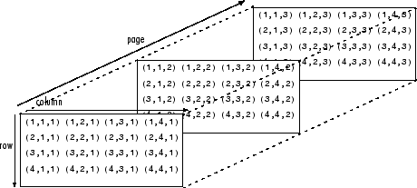
Array in C++
Three Dimensional Array
In multidimensional arrays data in the form of a table, that is in row-major order.
The general syntax of a 3-dimensional array is as below.
data_type array_name[size1][size2][size3];
int x[2][3][4];

Slide 92
Function in C++
Function:
A function is block of code which is used to perform a particular task when it is called.
Functions are used to perform certain actions, and they are important for reusing code: Define the code once, and use it many times.
Depending on whether a function is predefined or created by programmer; there are two types of function:
Library Function : Library functions are the built-in function. Programmer can use library function by invoking function directly; they don't need to write it themselves.
Example: Sqrt.cpp
User-defined Function : The function created by the user according to the need.

Slide 93
Function in C++
Function Elements:
Generally, C++ function has three parts:
Function Prototype: declaring a function before calling a function is called function declaration or prototype which tells the compiler that at some point of the program we will use the function of the name specified in the prototype.
Function Call: means calling the function with a statement. When the program encounters the function call statement the specific function is invoked.
Function Definition: is a part where we define the operation of a function. It consists of the declarator followed by the function body.

Slide 94
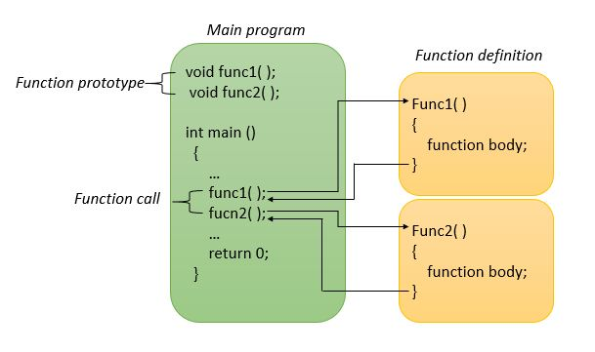
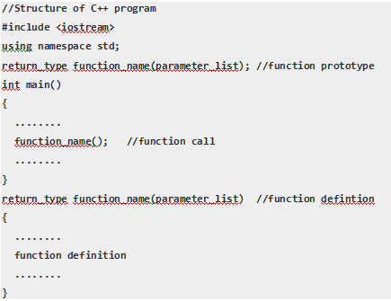
Function in C++
Function Elements:
You can pass data, known as parameters, into a function.
A parameter is a variable in a method definition. When a method is called, the arguments are the data you pass into the method's parameters. Parameter is variable in the declaration / definition of function. Argument is the actual value of this variable that gets passed to function.

Slide 95
Function in C++
User Defined Function Types :
For better understanding of arguments and return in functions, user
defined functions can be categorised as:
Function with no argument and no return value
Example: Function1.cpp
Function with no argument but return value
Example: Function2.cpp
Function with argument but no return value
Example: Function3.cpp
Function with argument and return value
Example: Function4.cpp
Note:
The particular method is chosen depending upon the situation and how you want to solve a problem.
Example: Menu_Driven1.cpp

Slide 96
Function in C++
Function Types based on Parameter Passing Mechanism :
A function in C++ can take arguments passed by value, by pointer, or by reference.
The arguments passed y reference is an enhancement over C.
Pass by value: A Copy of the actual parameters in the function call is assigned to the formal parameters.
Pass by Pointer: The address of the actual parameters is passed to the formal parameters.
Pass by Reference: An alias (reference) of the actual parameters is passed to the formal parameters.
Note: References are generally implemented using pointers. A reference is same object, just with a different name and reference must refer to an object.
Example: pass_value.cpp, pass_pointer.cpp, pass_reference.cpp

Slide 97
Inline Function in C++
Need?
One of the major objectives of using functions in a program is to save memory space, which becomes appreciable when a function is likely to be called many times.
However, every time a function is called, it takes a lot of extra time in executing tasks such as jumping to the calling function.
When a function is small, a substantial percentage of execution time may be spent in such overheads and sometimes maybe the time taken for jumping to the calling function will be greater than the time taken to execute that function.

Slide 98
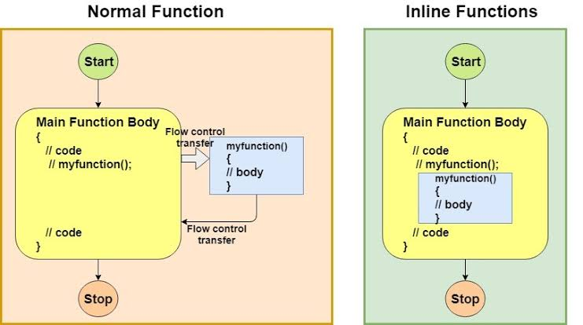
Inline Function in C++
What is Inline function?
To eliminate the time of calls to small functions, C++ proposes a new function called inline function.
An inline function is a function that is expanded in line when it is invoked thus saving time. The compiler replaces the function call with the corresponding function code that reduces the overhead of function calls.

Slide 99
Inline Function in C++
Syntax
inline return-type function-name(parameters)
{
// function code
}
Example: inline.cpp, inline_factorial.cpp
Advantages:
Function call overhead doesn’t occur. It saves the overhead of a return call from a function.
When we use the inline function it may enable the compiler to perform
context-specific optimization on the function body, such optimizations are not possible for normal function calls.
An inline function may be useful for embedded systems because inline can yield less code than the function call preamble and return.

Slide 100
Inline Function in C++
Disadvantages:
If you use too many inline functions then the size of the binary executable file will be large, because of the duplication of same code.
Too much inlining can also reduce your instruction cache hit rate, thus reducing the speed of instruction fetch from that of cache memory to that of primary memory.
Inline function may increase compile time overhead if someone changes the code inside the inline function then all the calling location has to be recompiled because compiler would require to replace all the code once again to reflect the changes, otherwise it will continue with old functionality.
Inline functions may not be useful for many embedded systems. Because in embedded systems code size is more important than speed.
Inline functions might cause thrashing because inlining might increase size of the binary executable file. Thrashing in memory causes performance of computer to degrade.

Slide 101
Inline Function in C++
Limitations:
Remember, inlining is only a request to the compiler, not a command. Compiler can ignore the request for inlining. Compiler may not perform inlining in such circumstances like:
1) If a function contains a loop. (for, while, do-while)
Note: A function with loops can be made inline, But every time a function
is called, there is a certain amount of performance overhead that occurs.
2) If a function contains static variables.
3) If a function is recursive.
4) If a function return type is other than void, and the return statement
doesn’t exist in function body.
5) If a function contains switch or goto statement.

Slide 102
Default Arguments in C++
What?
A default argument is a default value provided for a function parameter.
If the user does not supply an explicit argument for a parameter with a default argument, the default value will be used.
If the user does supply an argument for the parameter, the user-supplied argument is used.
Need?
Because the user can choose whether to supply a specific argument value, or use the default, a parameter with a default value provided is often called an optional parameter.

Slide 103
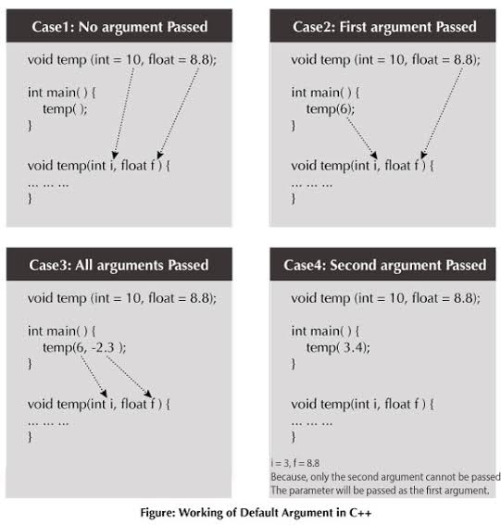
Default Arguments in C++

Slide 104
Default Arguments in C++
Example: defacult.cpp
Importance Points:
All default arguments must be for the rightmost parameters.
void printValue(int x=10, int y); // not allowed
Cannot mix a default argument in between two arguments.
void add(int a, int b = 3, int c, int d = 4); //not allowed
If more than one default argument exists, the leftmost default argument should be the one most likely to be explicitly set by the user.
Default arguments can only be declared once
If the function has a forward declaration, put the default argument there. Otherwise, put them in the function definition.

